Slide 1

Pittsburgh Penguins Business Intelligence Analyst Final Interview
Nithin Ragunathan
Thursday July 21st, 2022

Slide 2

Project Goal
To showcase data analysis and visualization skills using NHL attendance data

Slide 3
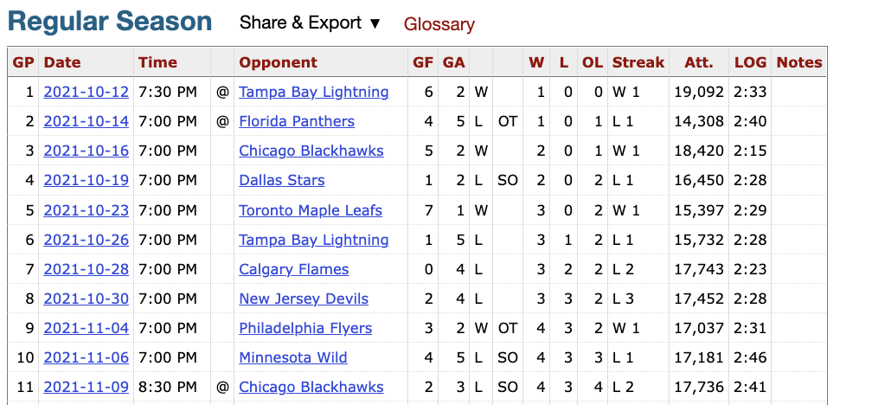
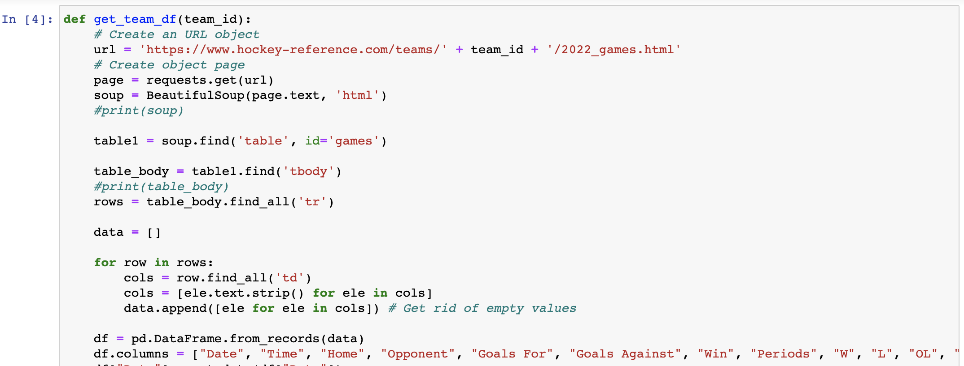
Data Collection
Source: https://www.hockey-reference.com
HTML table scraped from the web using the BeautifulSoup package (Python)

Slide 4




Development Tools
Python
BeautifulSoup Webscraper
Pandas library
SQL
Database instance storing attendance data for 32 NHL teams and all 1312 regular season games
Tableau
Data visualization and Dashboarding

Slide 5

Demo

Slide 6
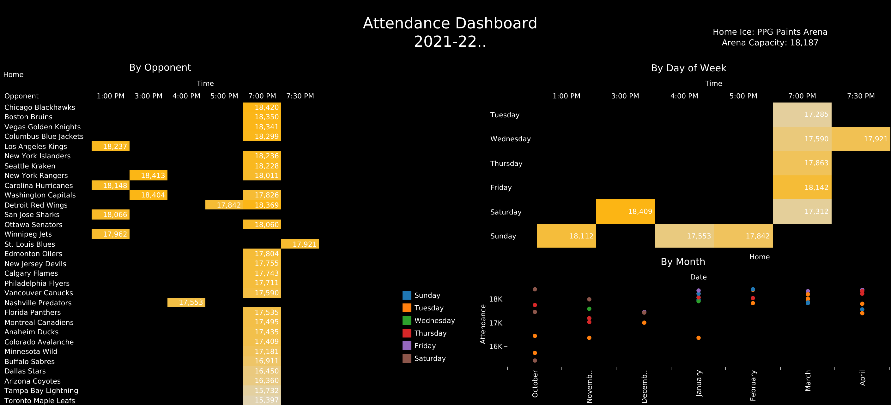
Conclusions
Attendance is highest on Friday nights and weekend afternoons
Attendance generally increases and varies less later in the season
Visiting teams:
Chicago draws the most fans
Toronto draws the least fans

Slide 7
Future Directions
Live updating from an API
Integrate ticket data
How do ticket prices affect attendance and revenue?
Analyze promotional nights
Road trip attendance analysis
Build regression model to predict future attendance and revenue

Slide 8
Thank you! Questions?

